Slide 1
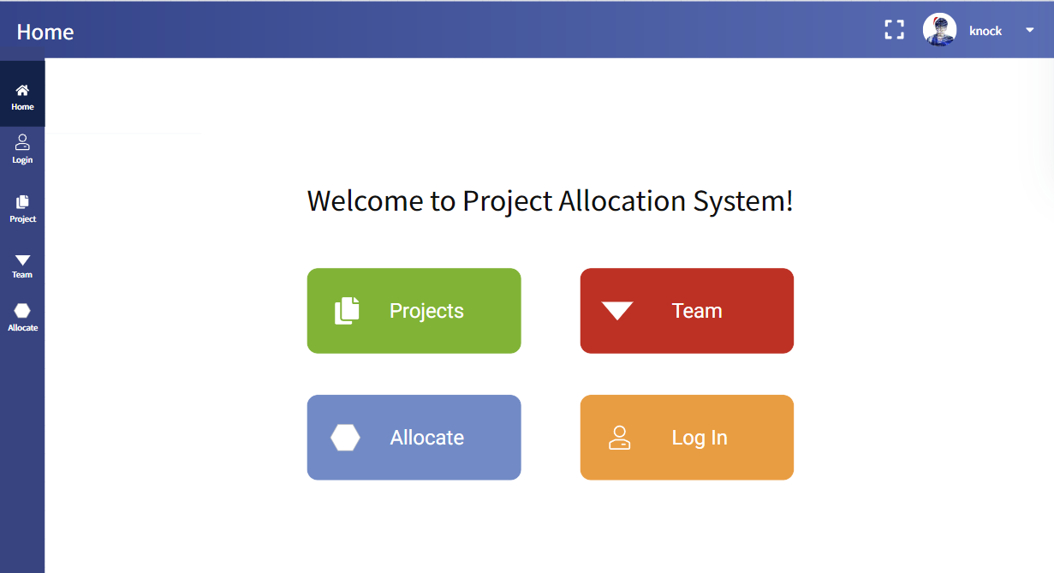

Slide 2
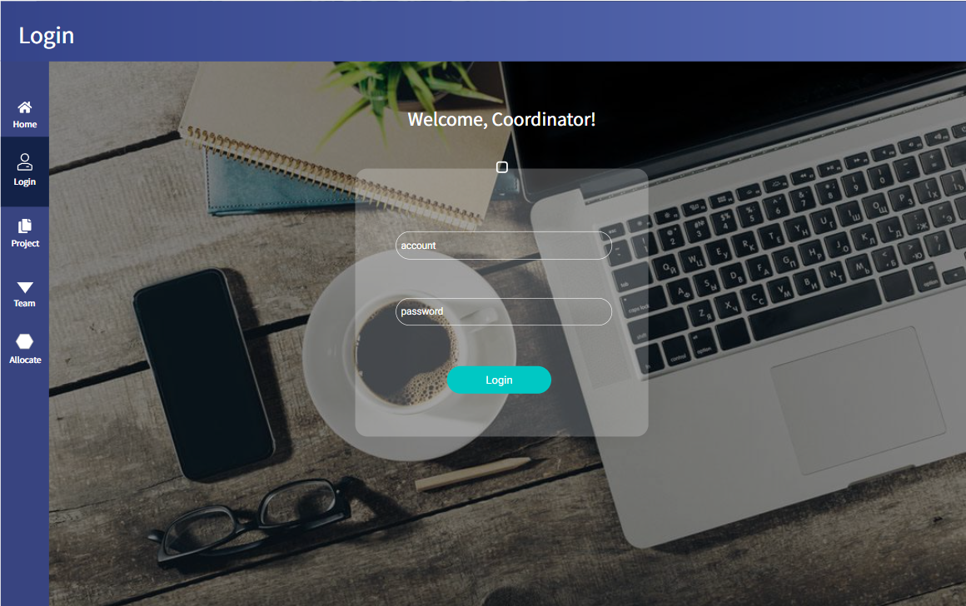

Slide 3
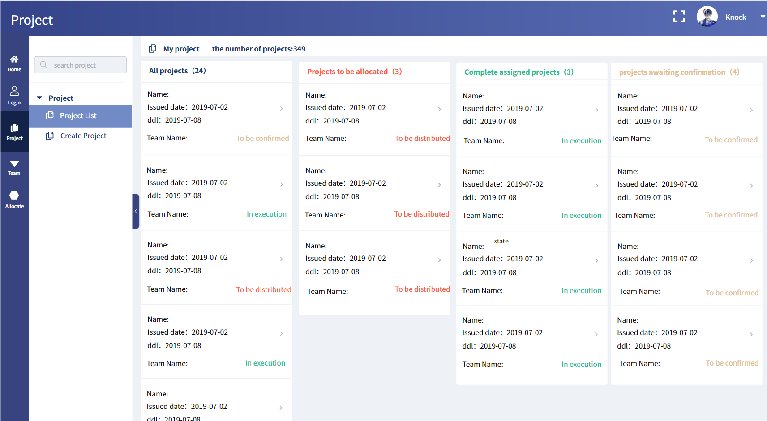

Slide 4
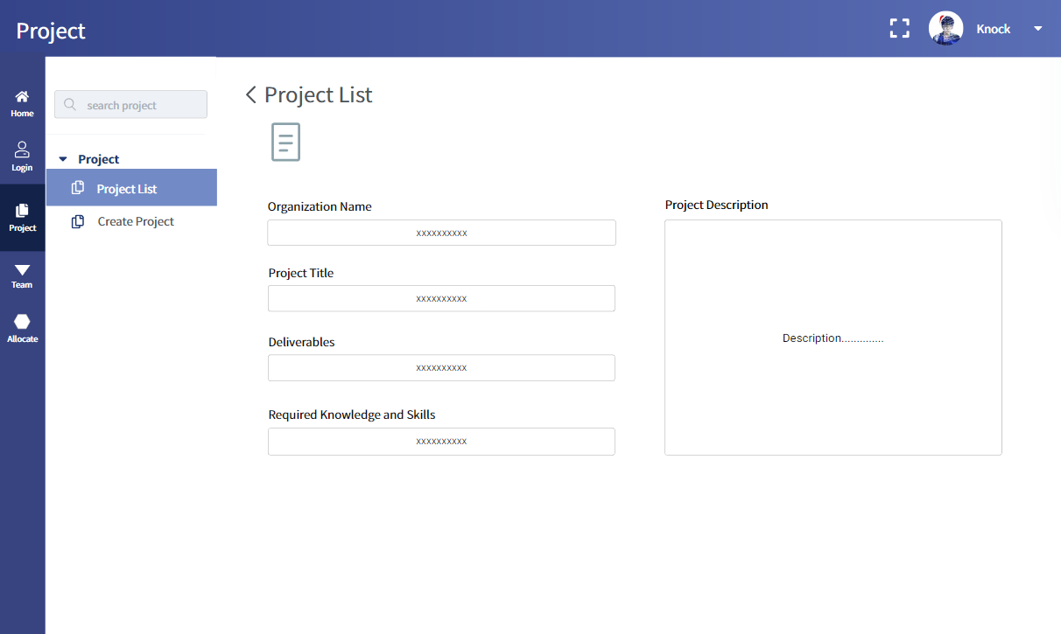

Slide 5
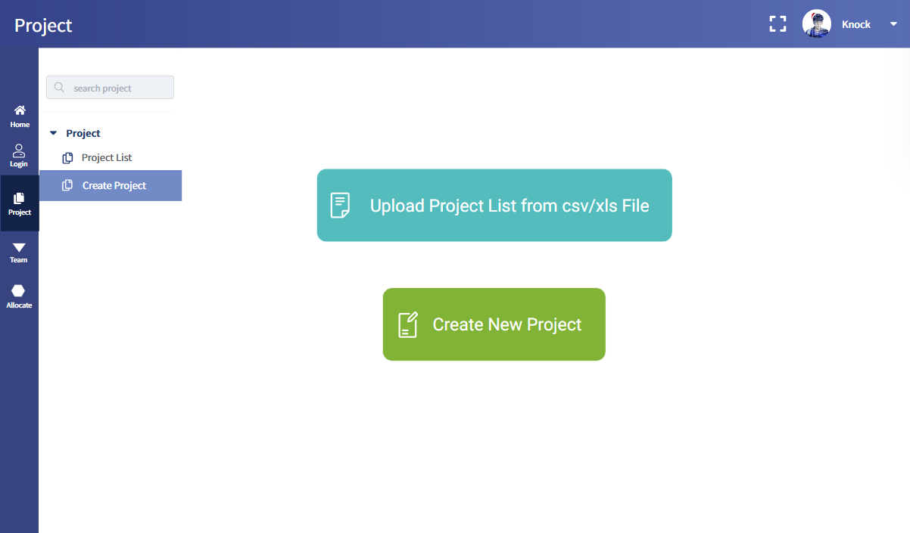

Slide 6
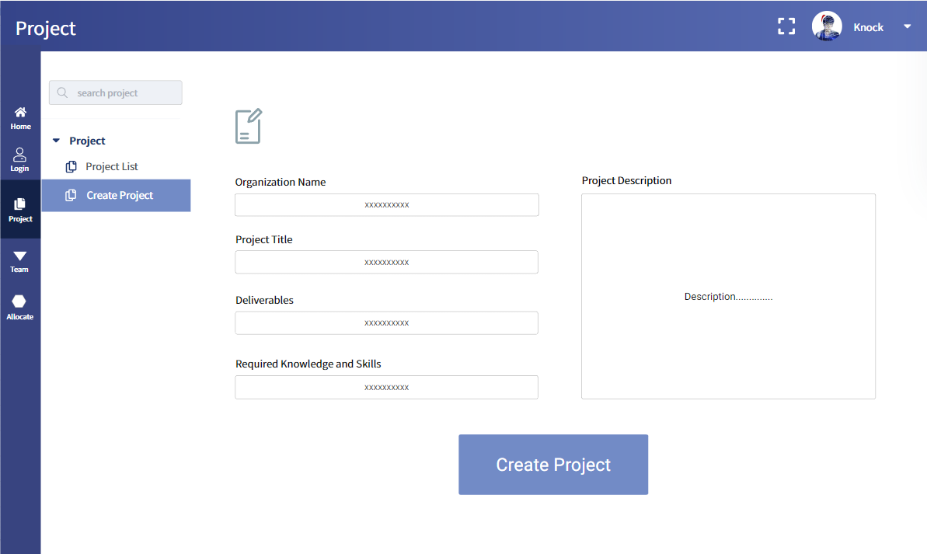

Slide 7
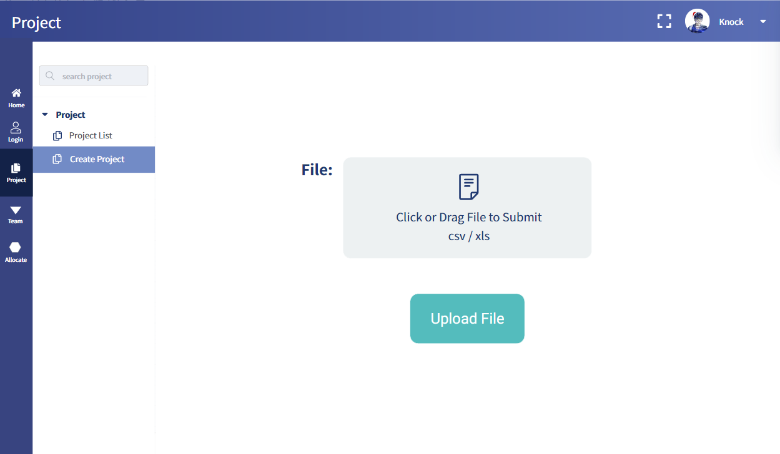

Slide 8
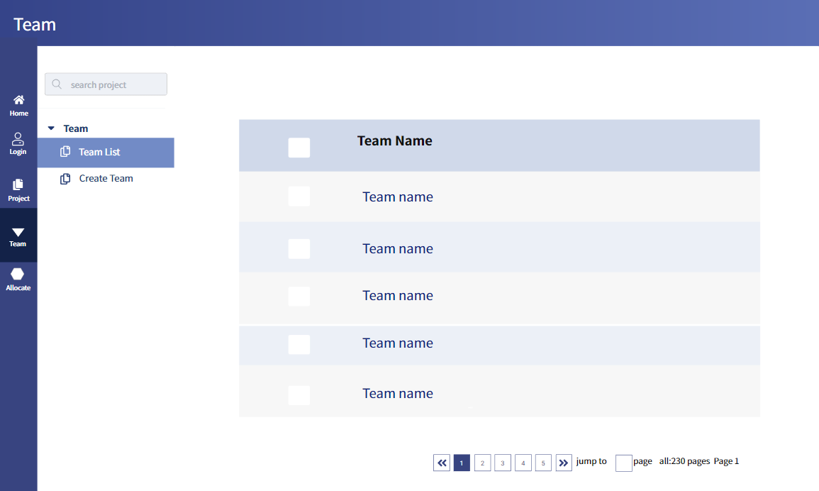

Slide 9
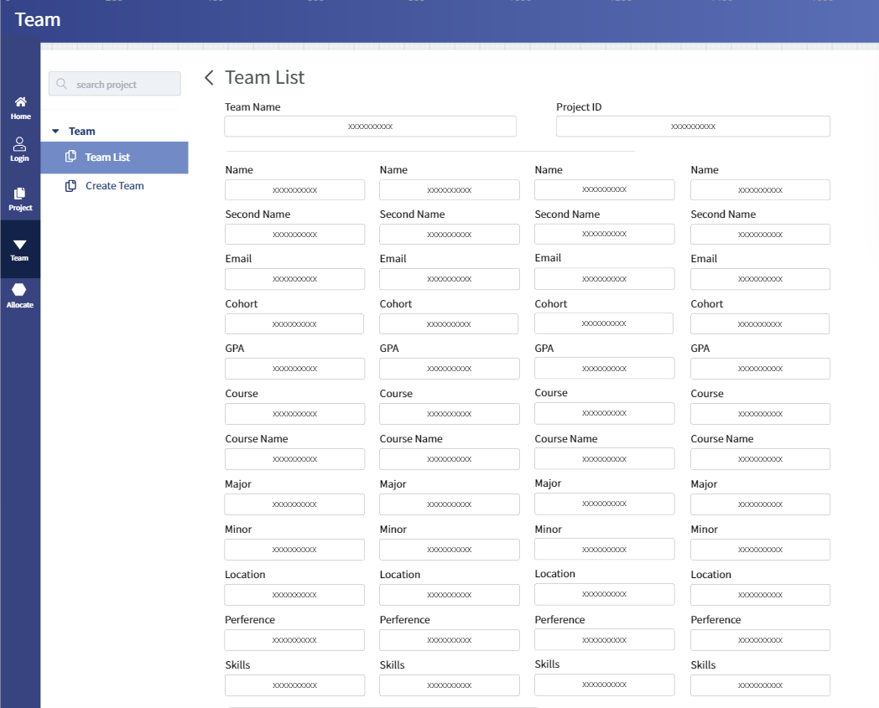

Slide 10
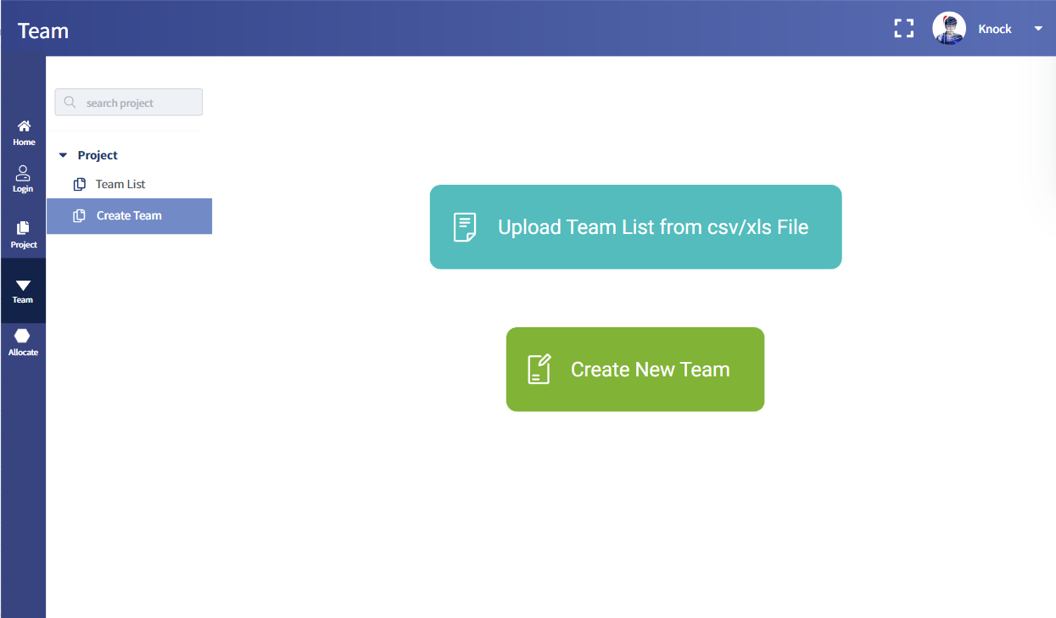

Slide 11
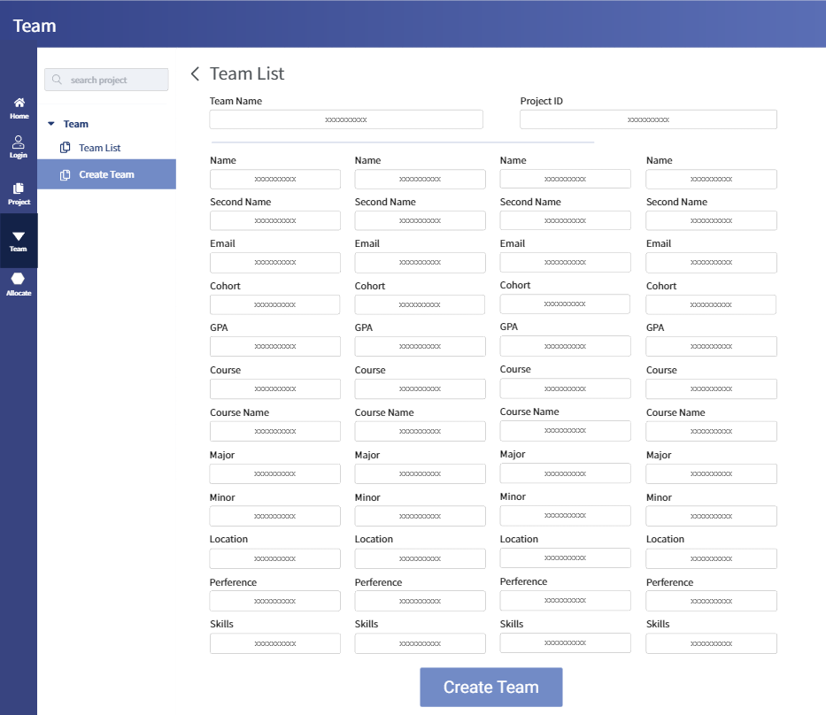

Slide 12
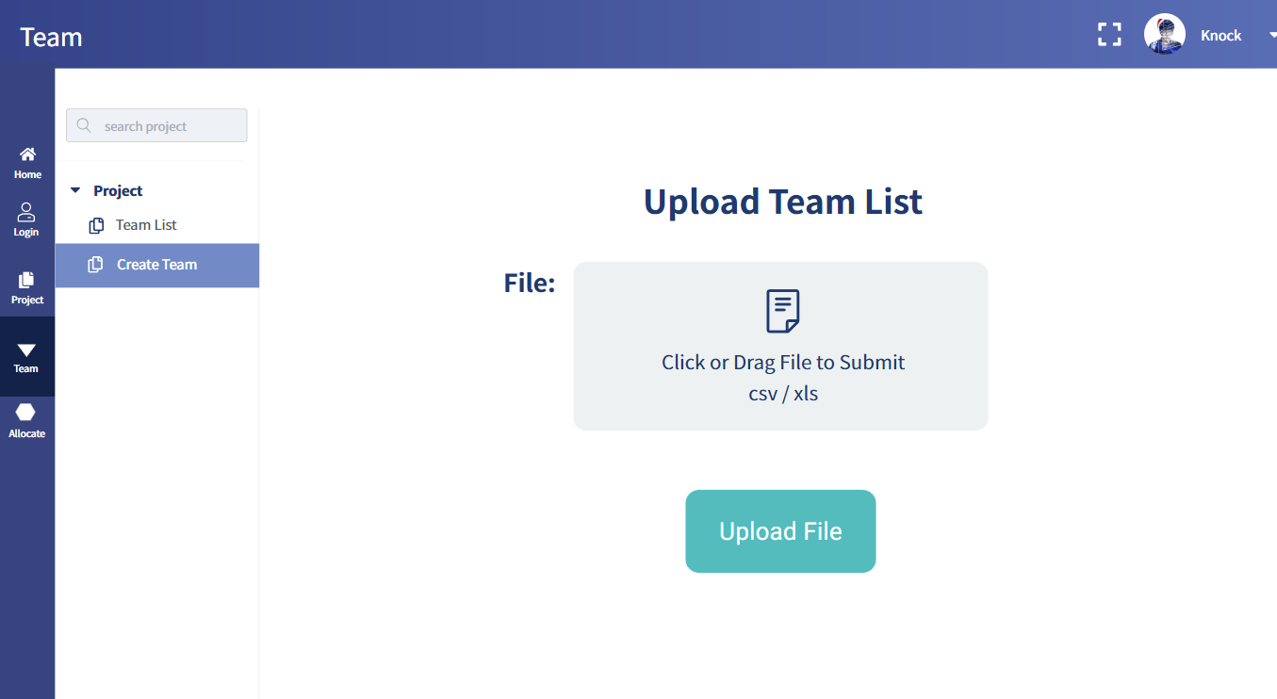

Slide 13
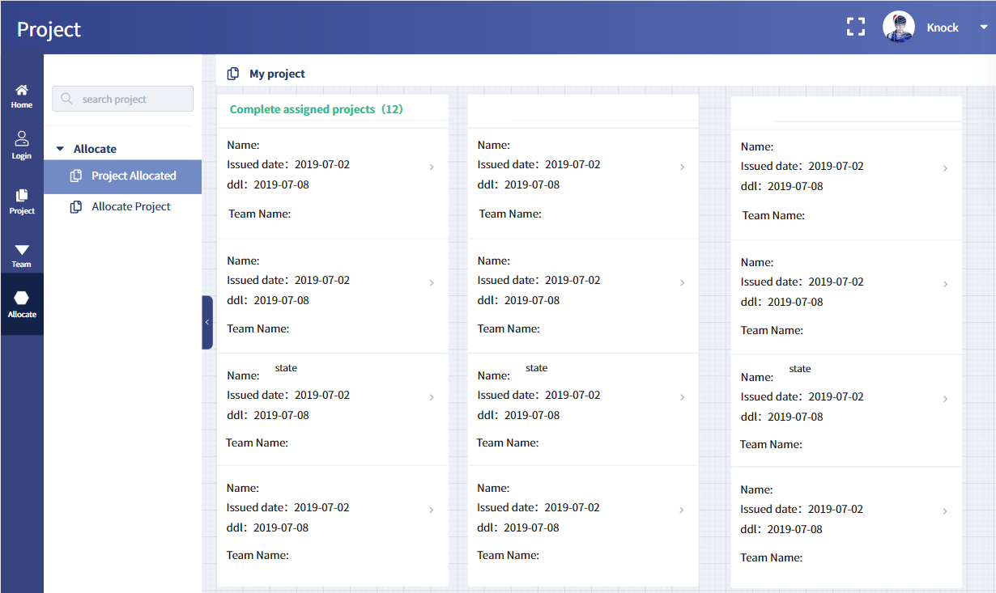

Slide 14
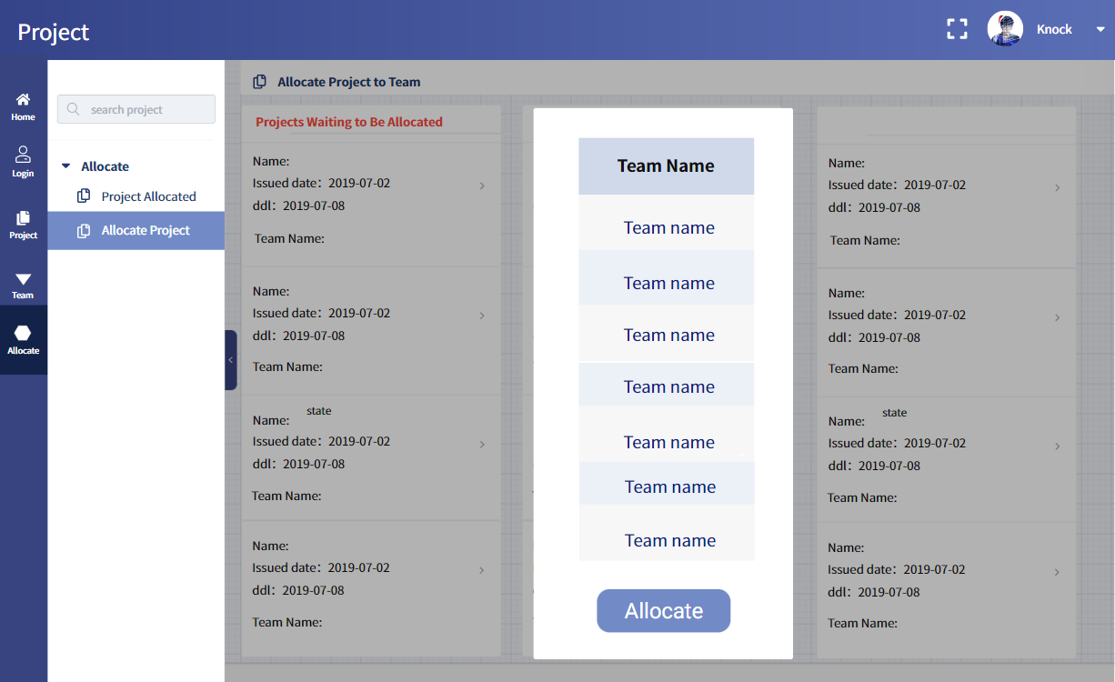

Slide 15
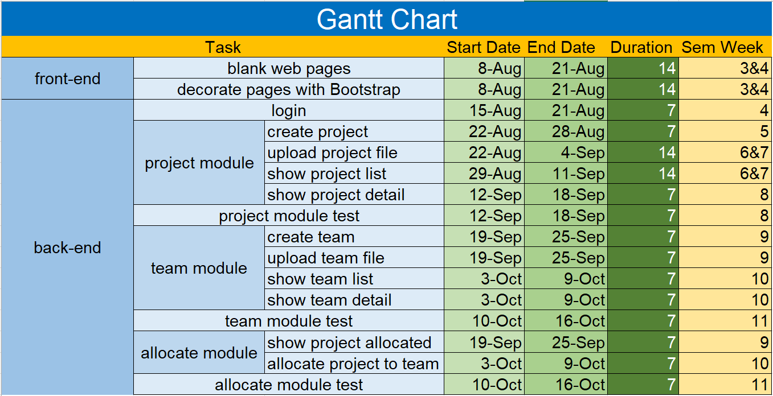

Slide 16
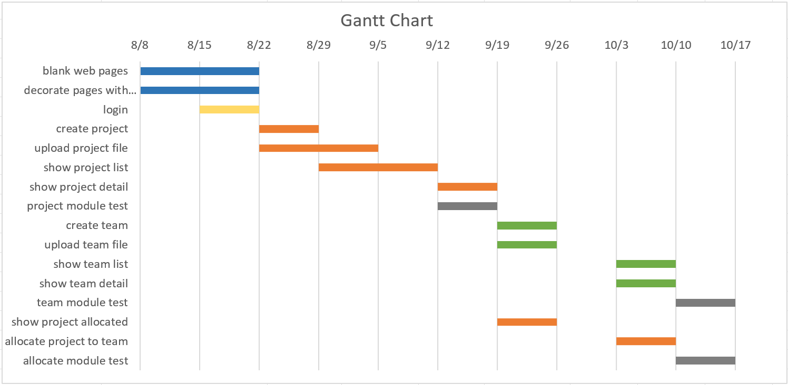

Slide 17
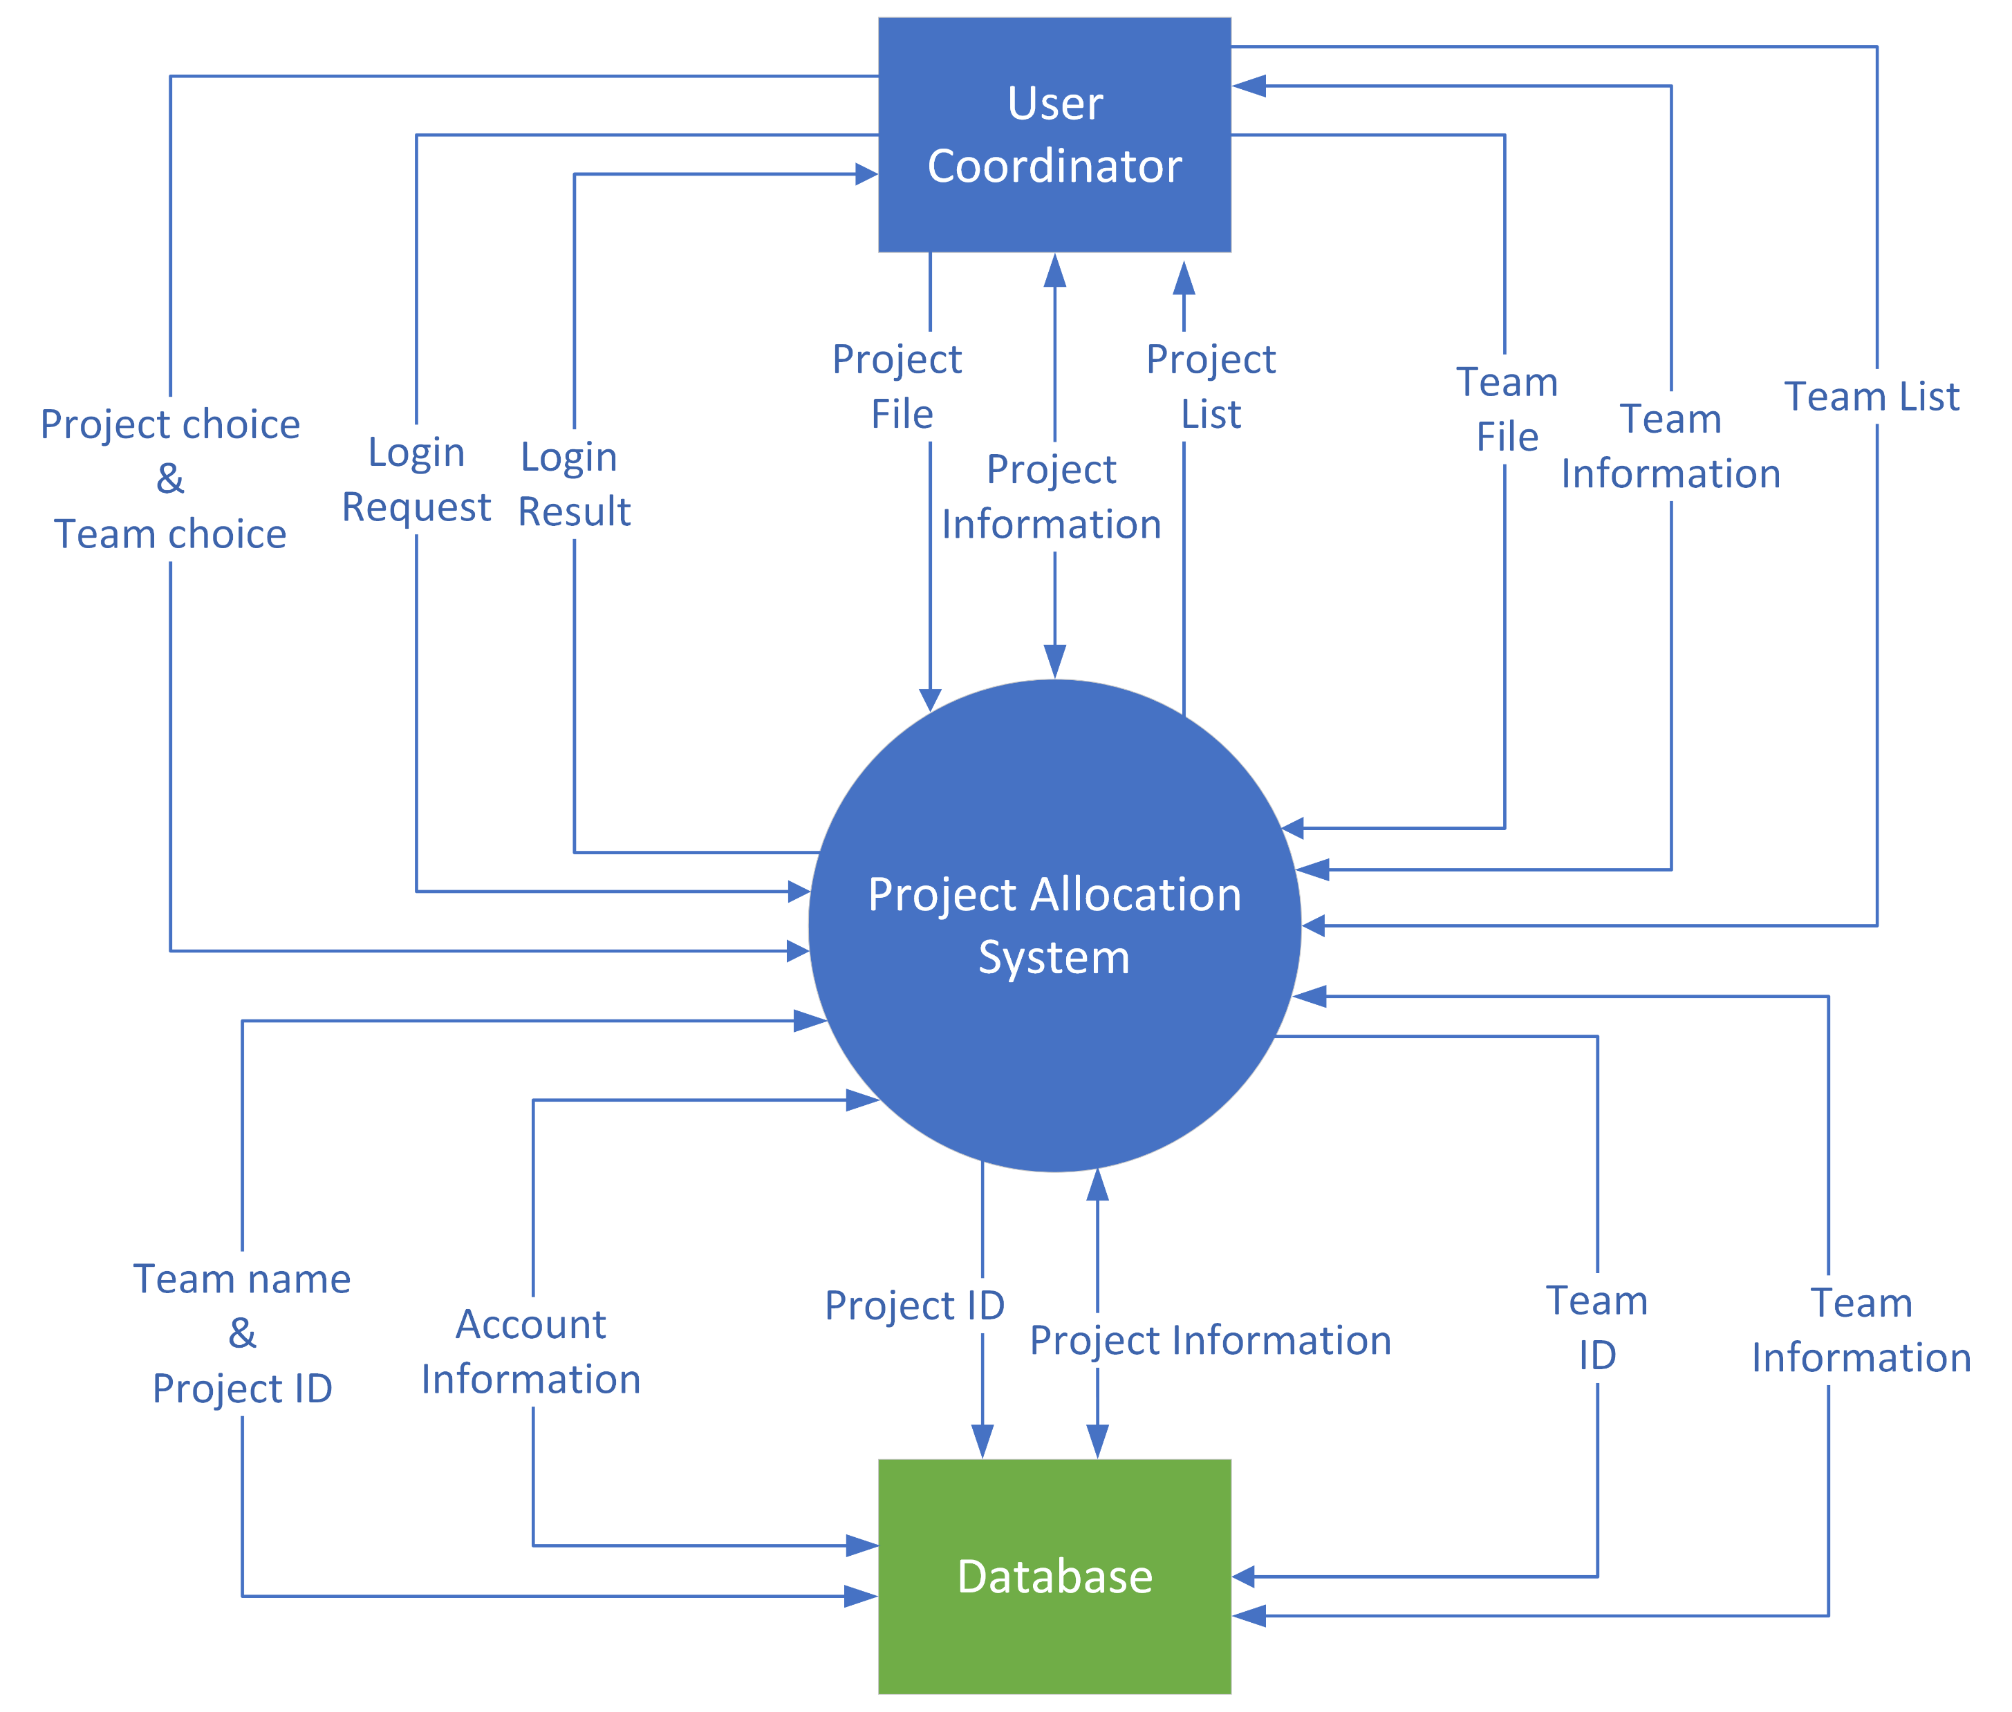
Context Diagram

Slide 18
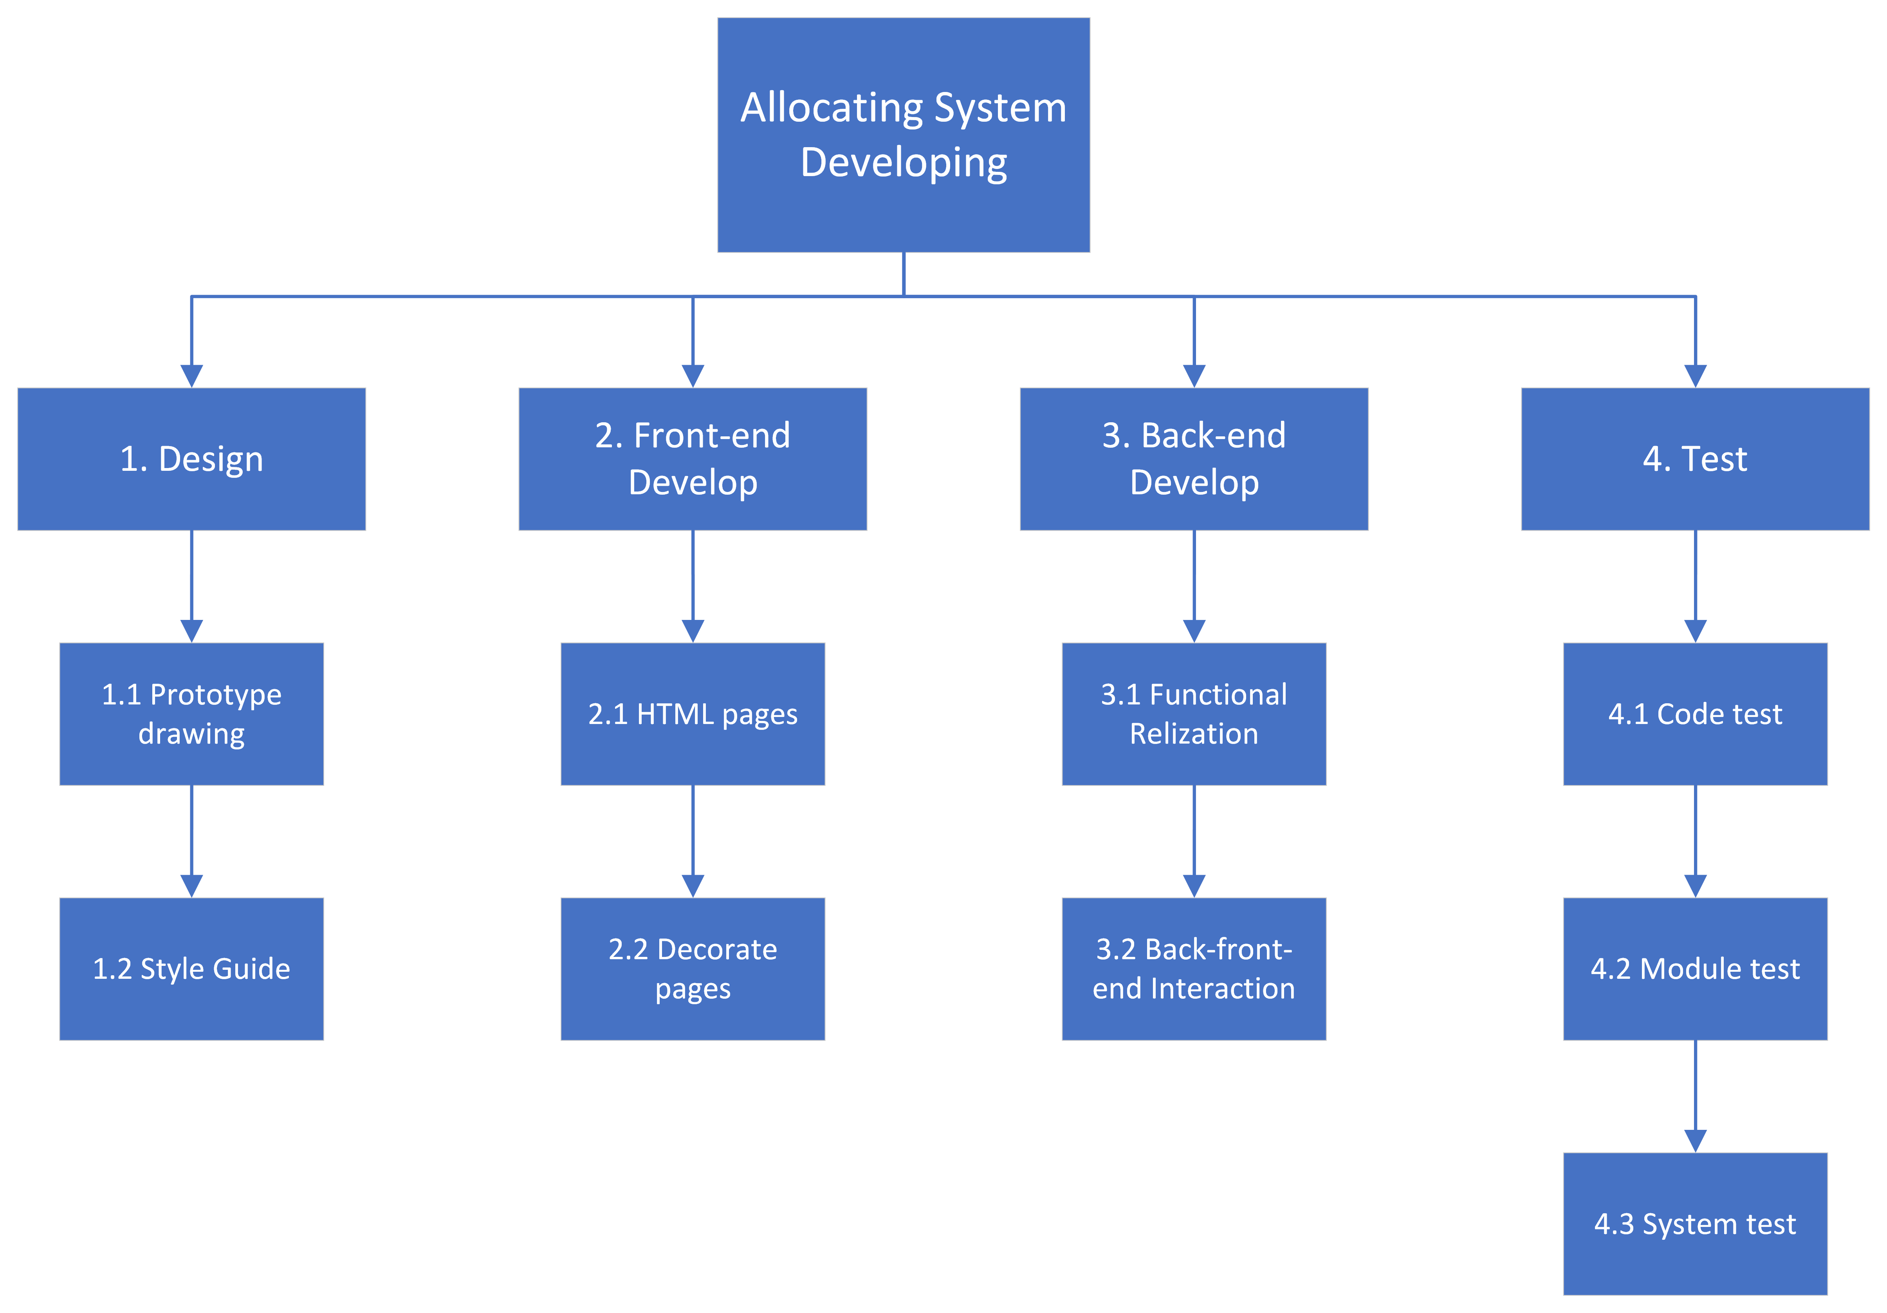
Work Breakdown Structure (WBS)

Slide 19
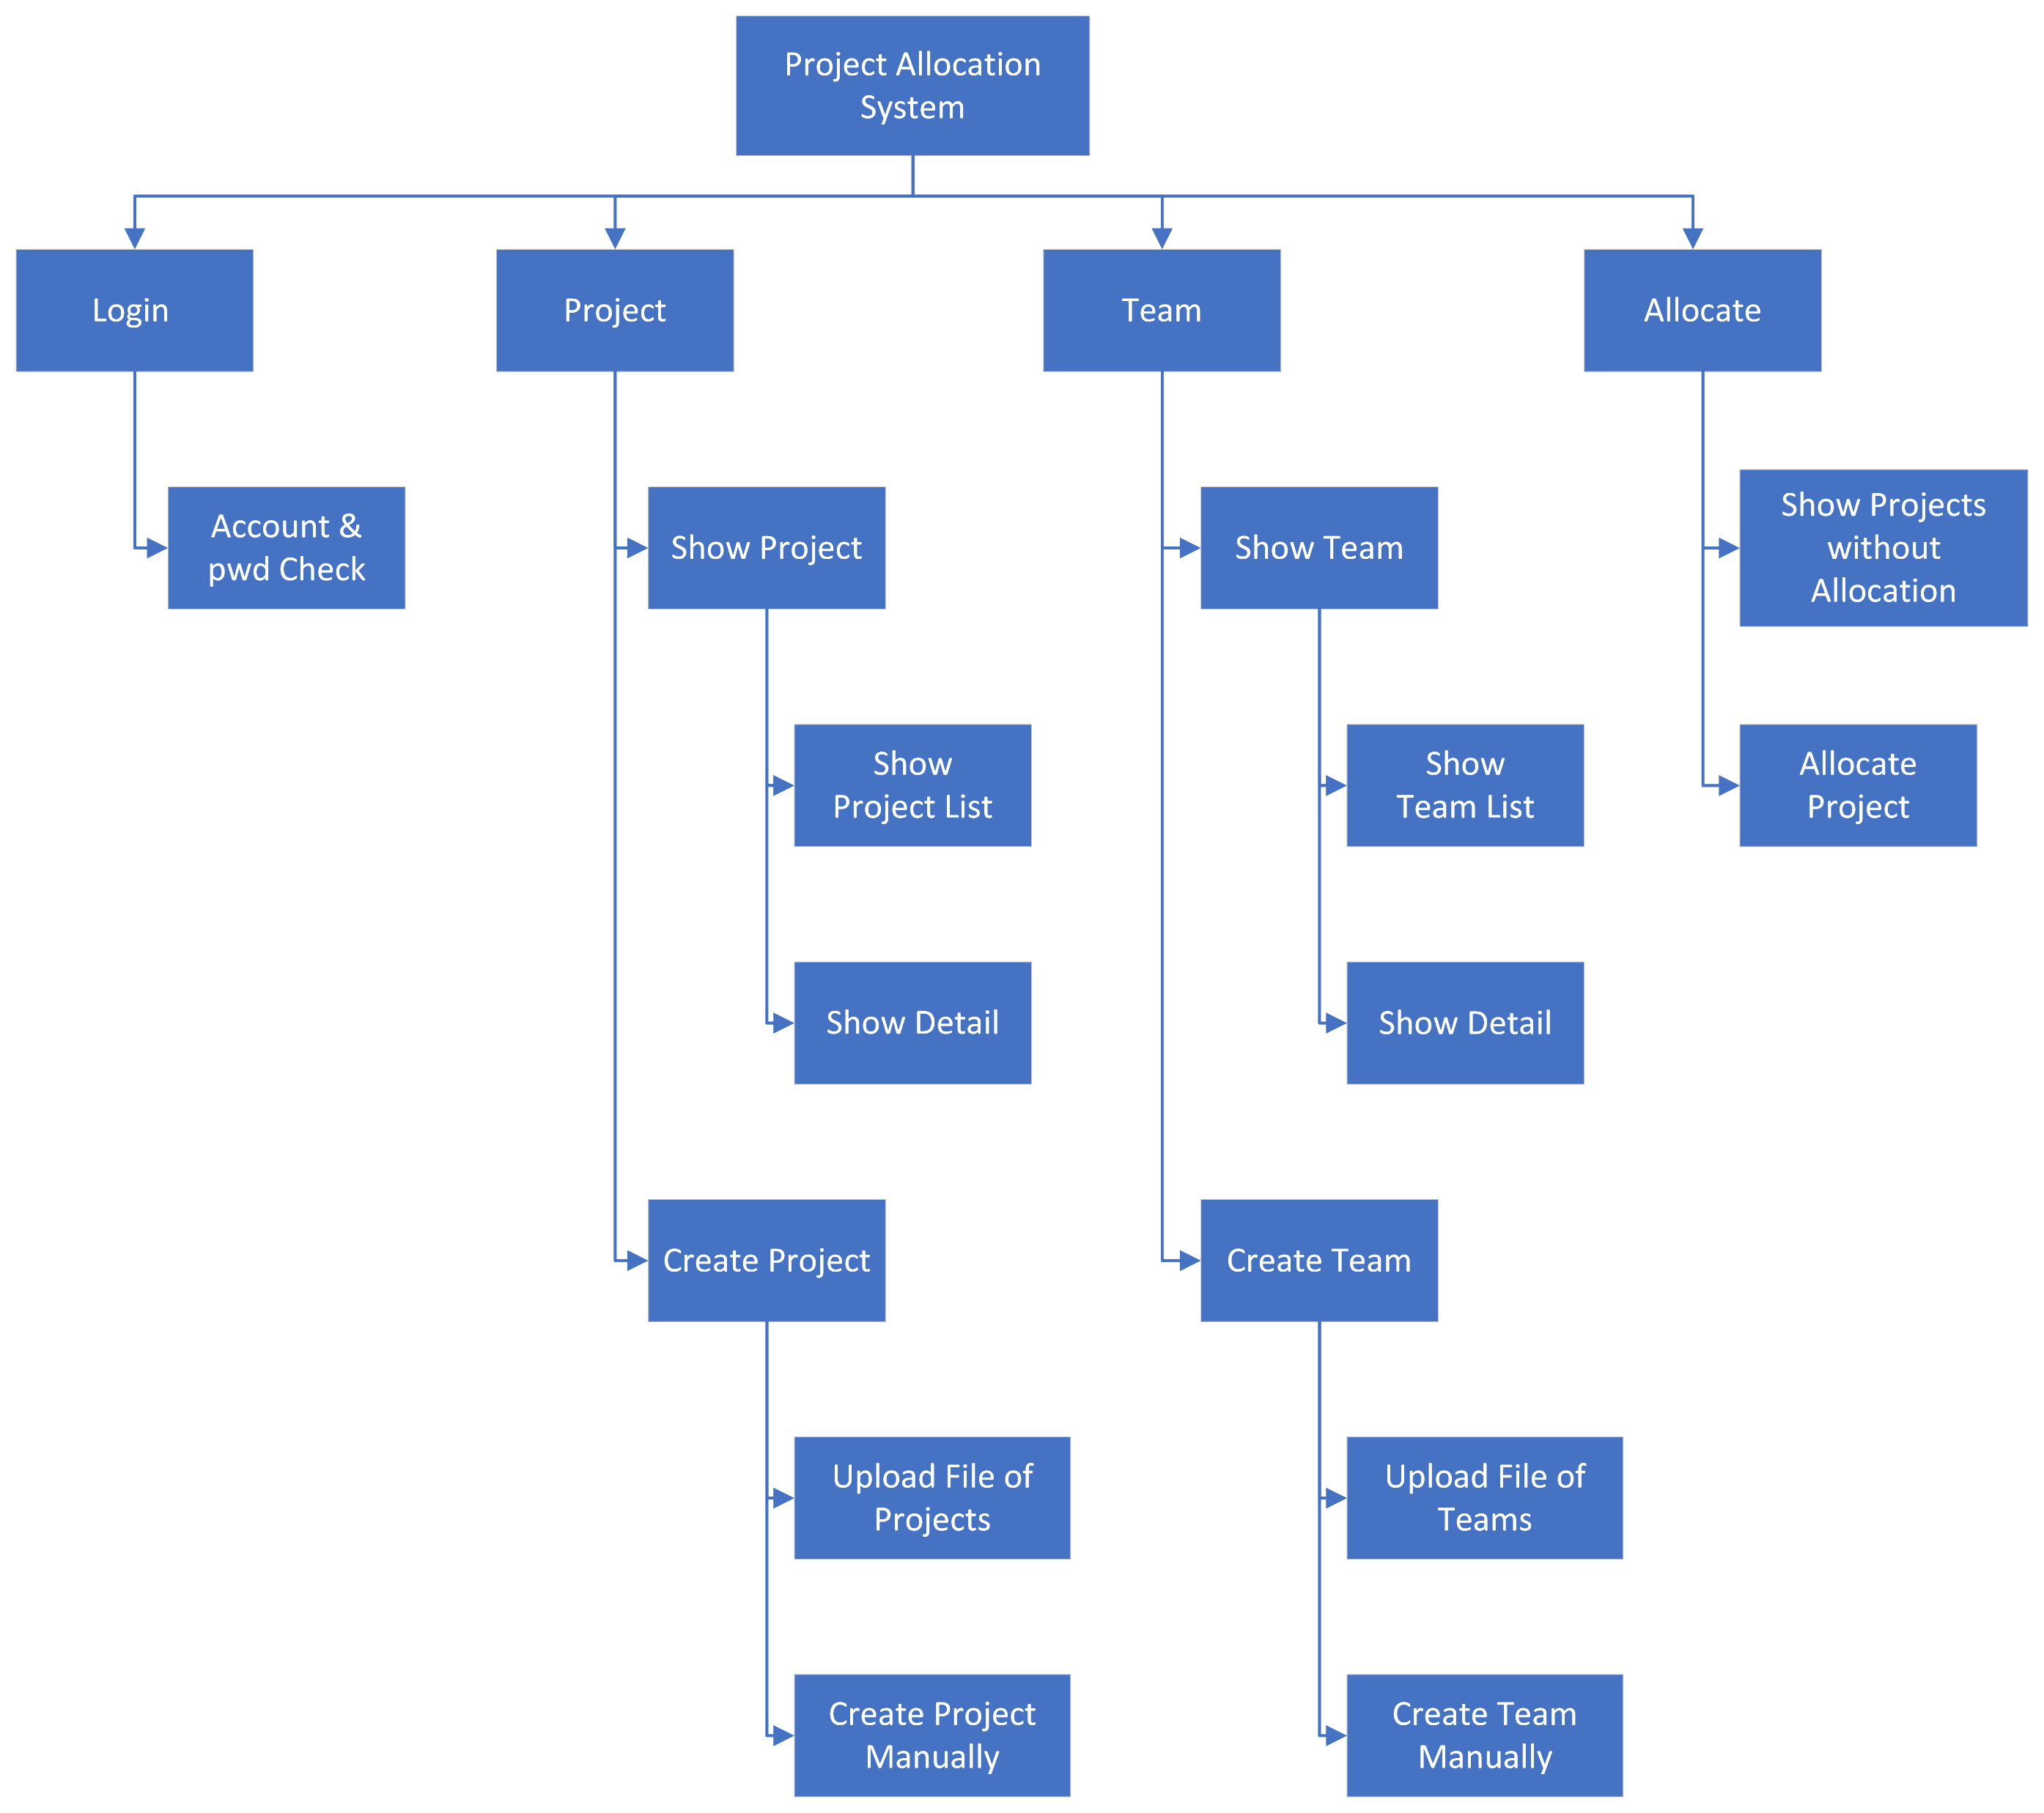
Product Breakdown Structure (PBS)

Slide 20
Risk Registry
Risk | Severity | Influence | risk mitigation strategy
1．equipment issues Due to equipment problems (network problems), members who do not live nearby cannot easily contact each other | Low | The work may be repeated, the workload may be wasted, and the communication may be inconvenient | The distribution plan has future work (and the members who live with them complete it in advance
2．Unknow Technical problems (database connection or display failure) | medium | The development speed of members has to be slow, and it takes time and effort to watch the code when other members assist | Multi backup and multi function annotation
3．Imprecise estimate of project time/resources | medium | There will be great delays, if possible | Leave time for operation (such as completing the function as soon as possible
4．Misunderstandings about function completion | medium | It is very difficult to modify the function, which may be very dangerous and difficult to complete the task | Every function needs to be annotated and every page needs to be routed
5. Problems caused by unsaved | Low | The system crashed and the function was broken | Make more backups and upload them to all members for demonstration, and the recovery function will be faster after you have an impression
6. Conflict with other courses (due to different exam arrangements | Low | If there are too many courses and exams overlap, there is no time to continue the project | Pre perfect function

Slide 22
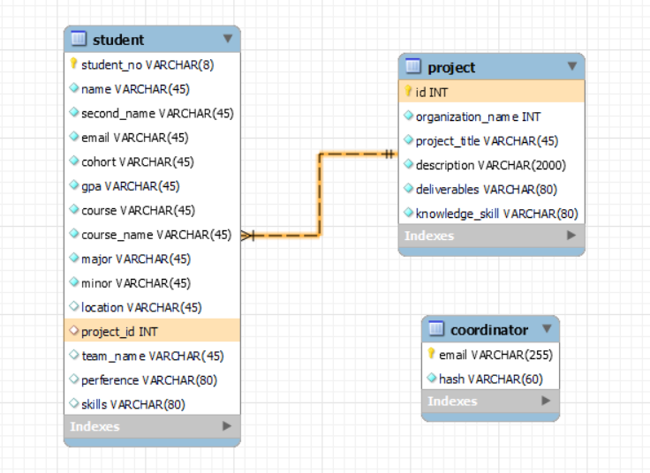

Slide 23
MySQL
JavaScript
React
JSX
Express
Bootstrap

